Slide 1
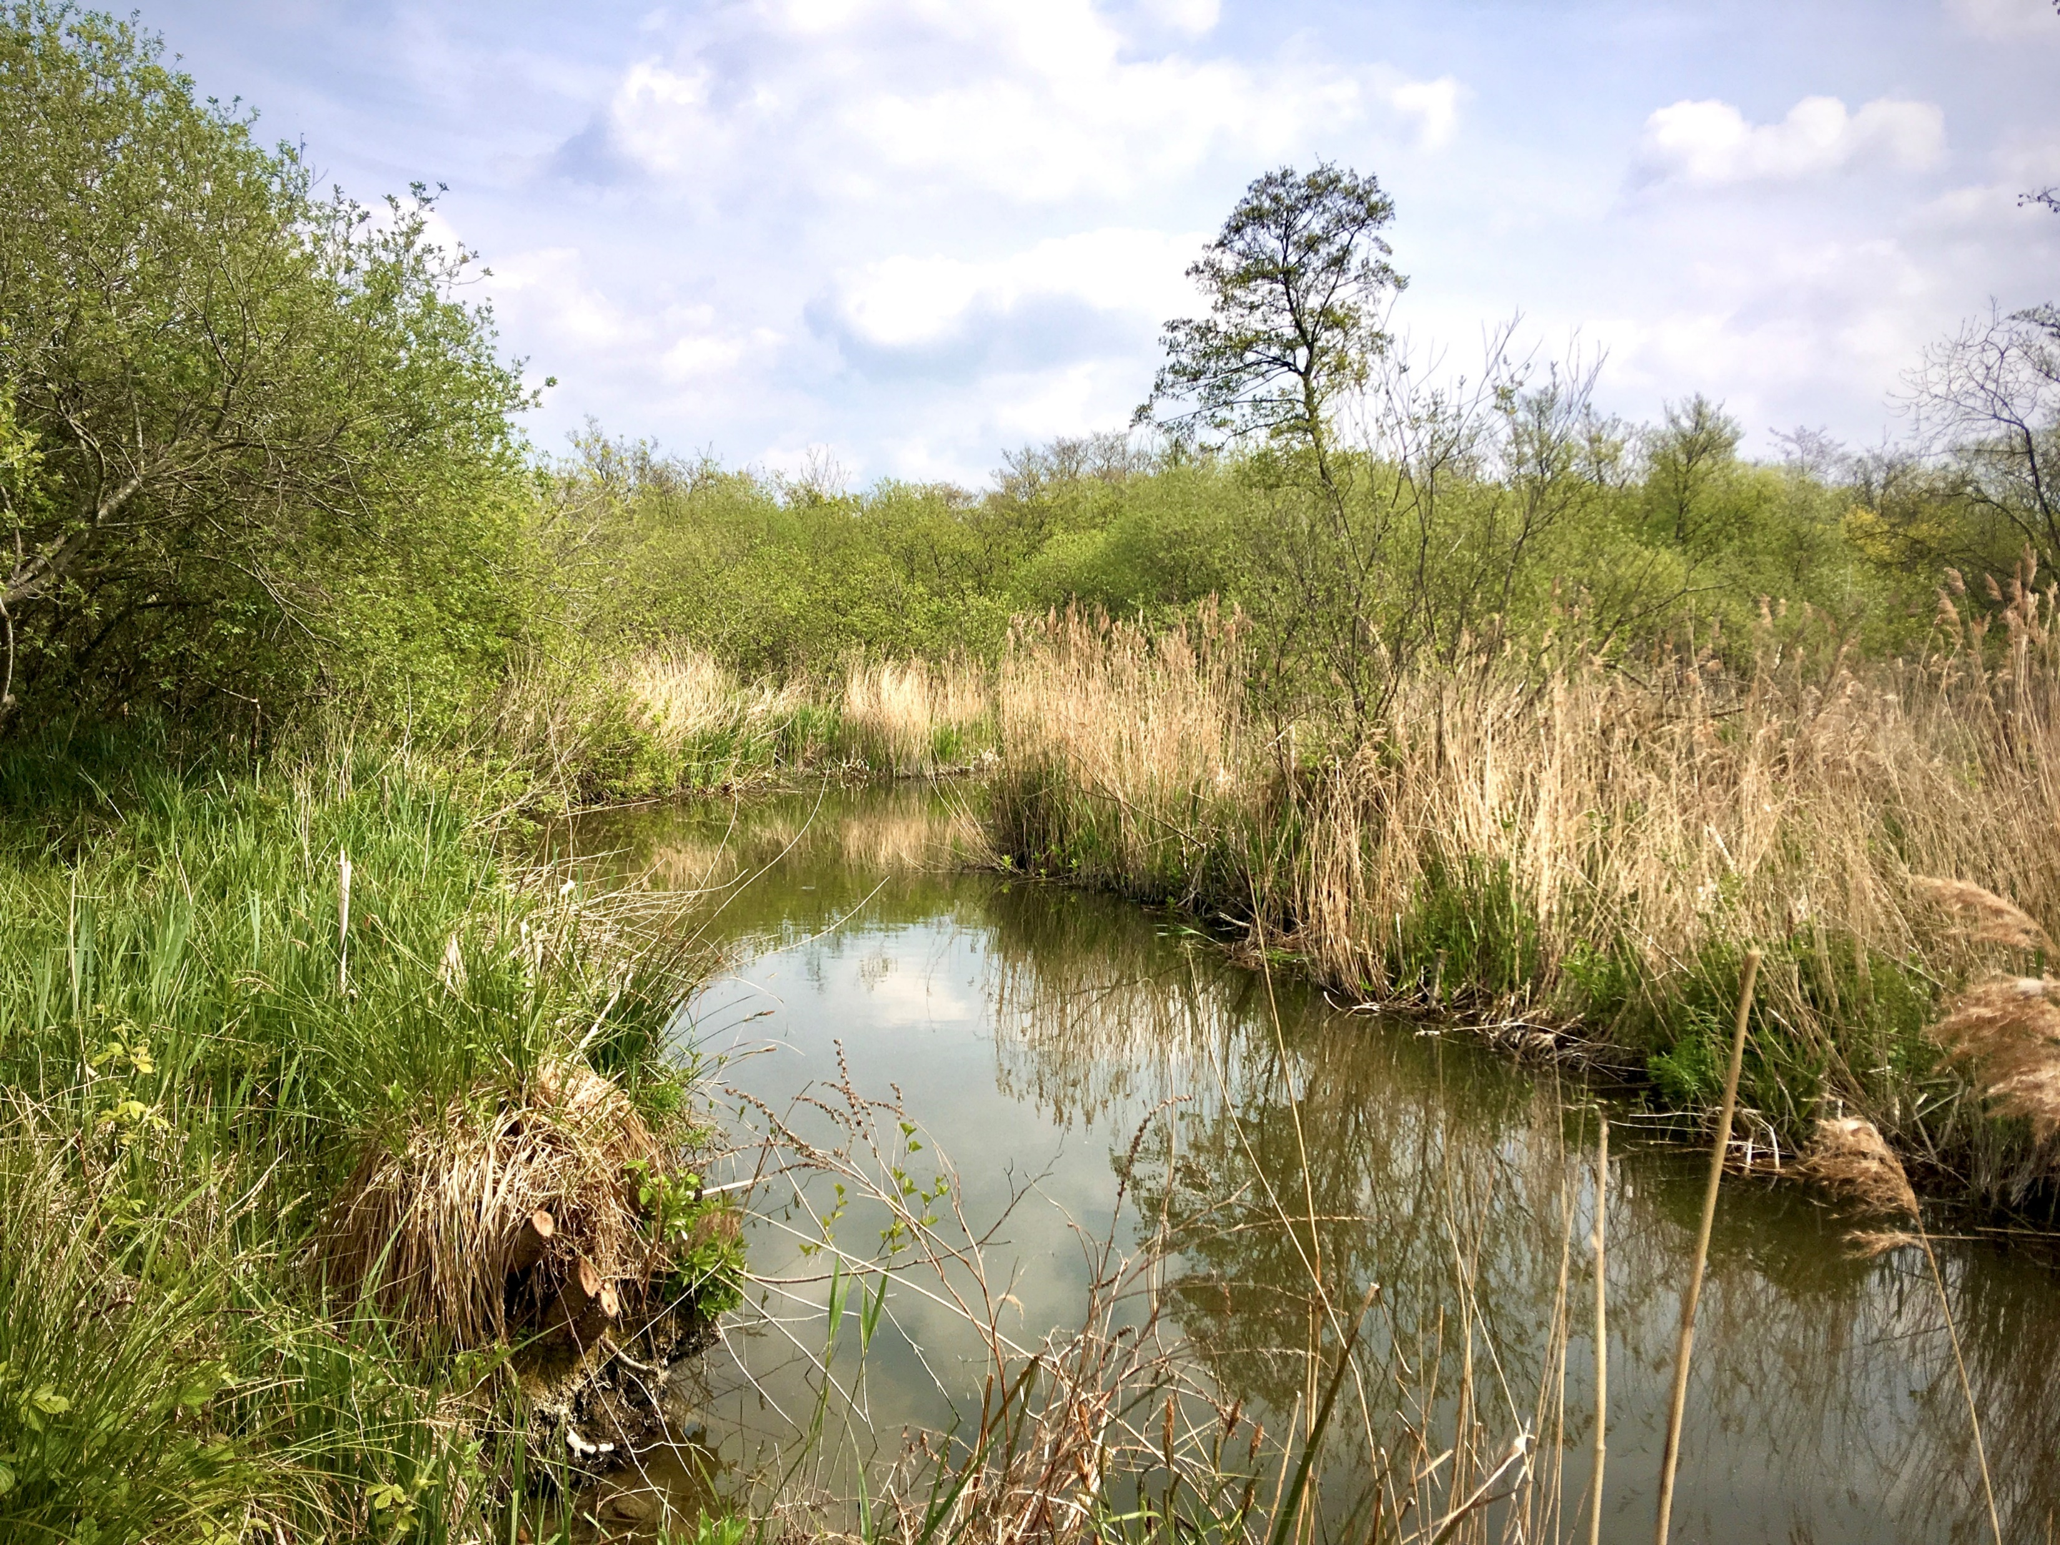
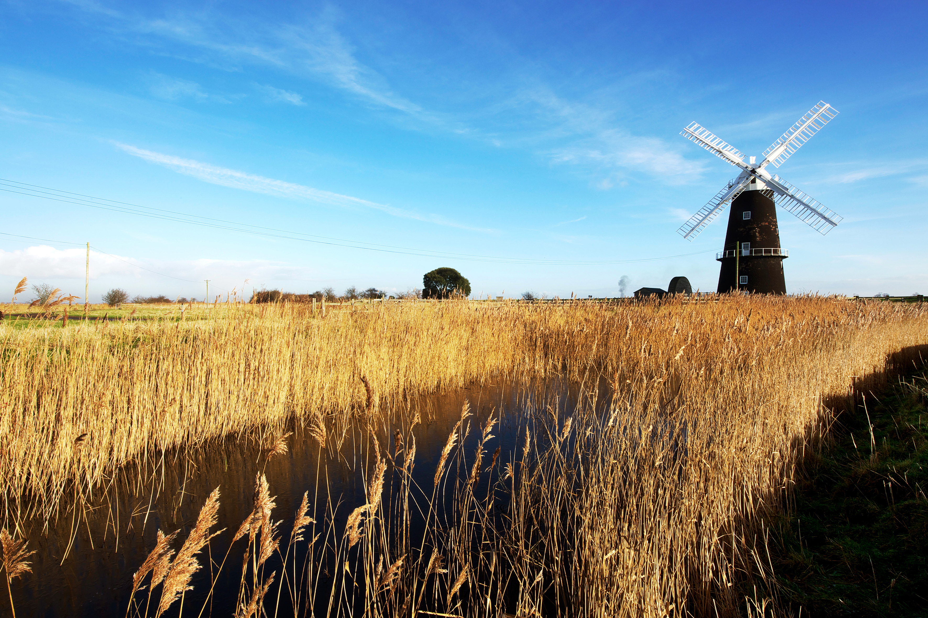
Geog
your memory
How much can you remember from last time?
What are the different land uses within the Broads?
How many Broads are there?
What makes a good annotation?
Educational resource partner providers

Slide 2
The Broads in numbers
In this lesson, we will:
Examine the value of tourism to the Broads
Improve our ability to analyse real data
Mapping boat data in the Broads using GIS

Slide 3
What do we mean by ‘tourism’?
In no more than 20 words define the term:
TOURIST
‘A person who is visiting a place for pleasure
away from their local area’

Slide 4
The value of tourism in the Broads
Tourism is hugely important to the Broads – measuring specifically just how important, can only be discovered by considering actual tourism data.
Every several years the Broads Authority analyse their data and produce a STEAM report. The latest report covers the period 2009-17. The data provided is a selection of some of the key numbers from that report.
TASK:
Analyse the data and the graphs and add your answers in the grid.
Remember the following:
Trend | = pattern
Mean | = average
Anomaly | = odd-one-out
Range | = difference between highest and lowest
Finished?
Keep thinking…
How useful is this data? What are some of the limitations?
How may the coronavirus outbreak in 2020 affect these figures?

Slide 5
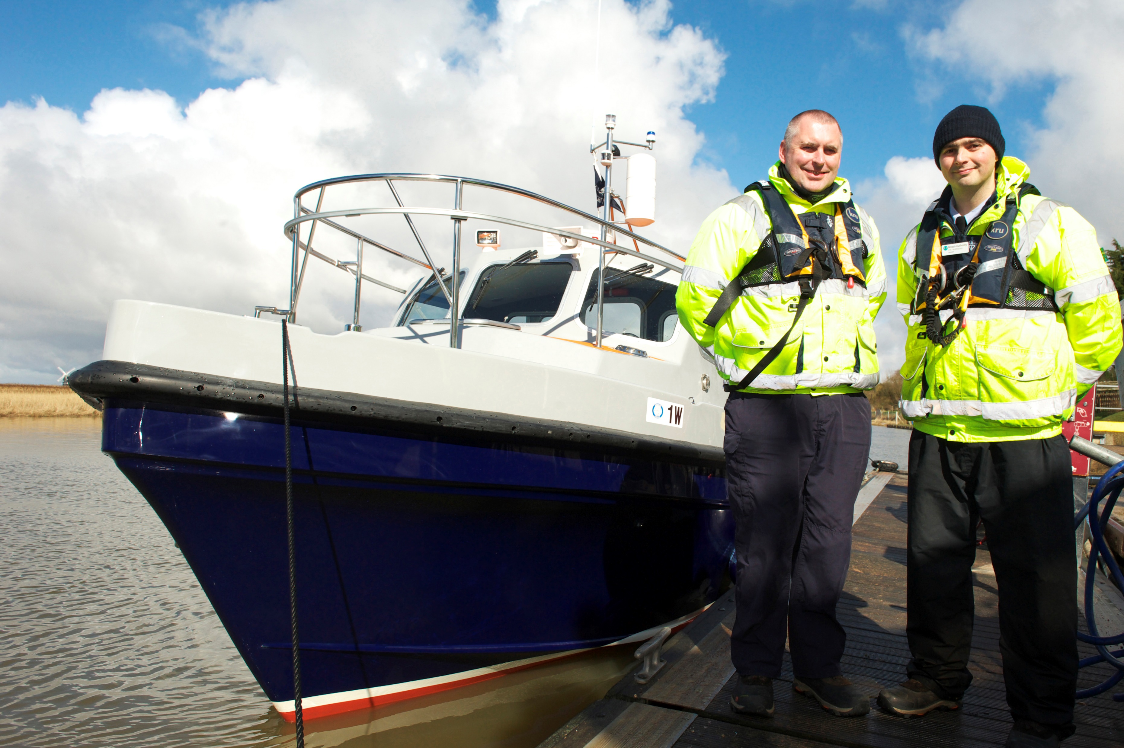
Improve our ability to analyse real data
Meet 2 of the Broads Authority rangers. It is part of their job to complete a boat census every 4 years. The last census was completed in 2018 over 3 days in the summer.
Over 3 days a team of 63 people at 14 locations recorded boat movements on the Broads, these were the results…
=

Slide 6
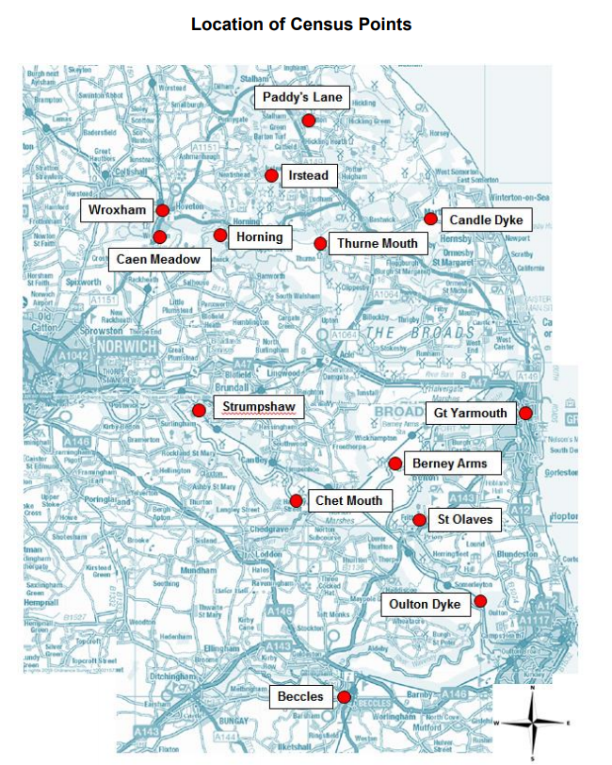
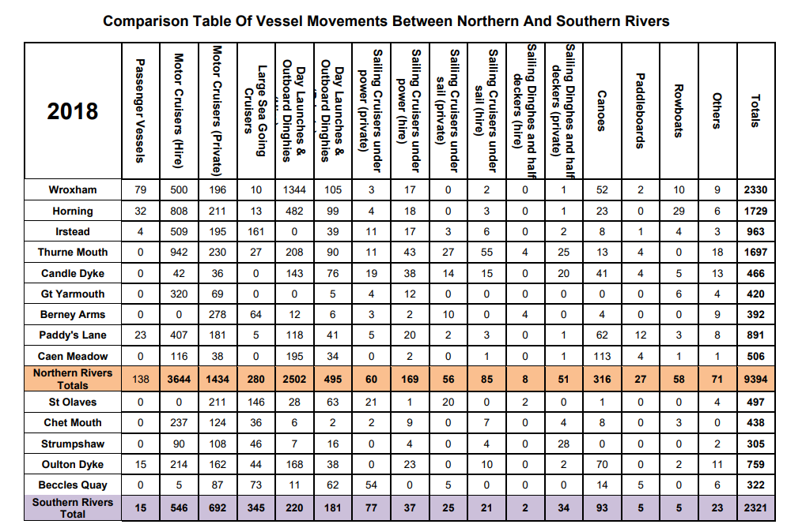
How useful is this data? What are some of the limitations?
Improve our ability to analyse real data
This data is general and is not specific to places within the Broads –
If possible, it is much more useful to see display data on a map to show where it was collected and to improve its relevance – this is called ‘geolocated’ data.
GIS
We can use Geographical Information Systems to present geolocated data
GIS could make better use of this data and make it far easier to read and interpret. For example…

Slide 7
Improve our ability to analyse real data
What categories are there in the boat survey?
+ Other
Passenger vessels
Motor cruisers
Sea-going cruisers
Day boats
Sailing boats
Rowing boats
Canoes / Kayaks
Paddleboards

Slide 8
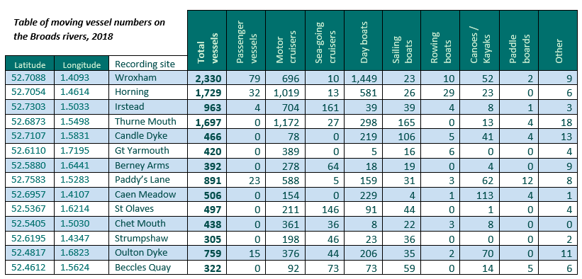
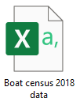
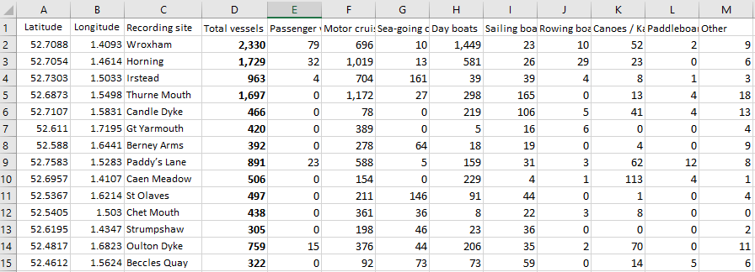
Mapping boat data in the Broads using GIS
Step 1
Add your data into an Excel spreadsheet
Save this in a CSV format

Slide 9
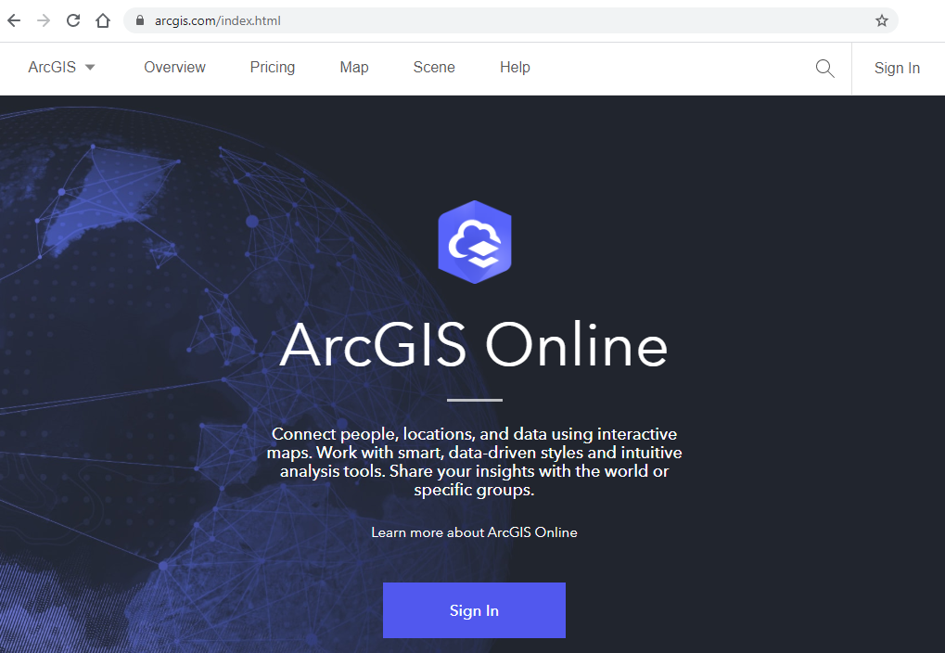
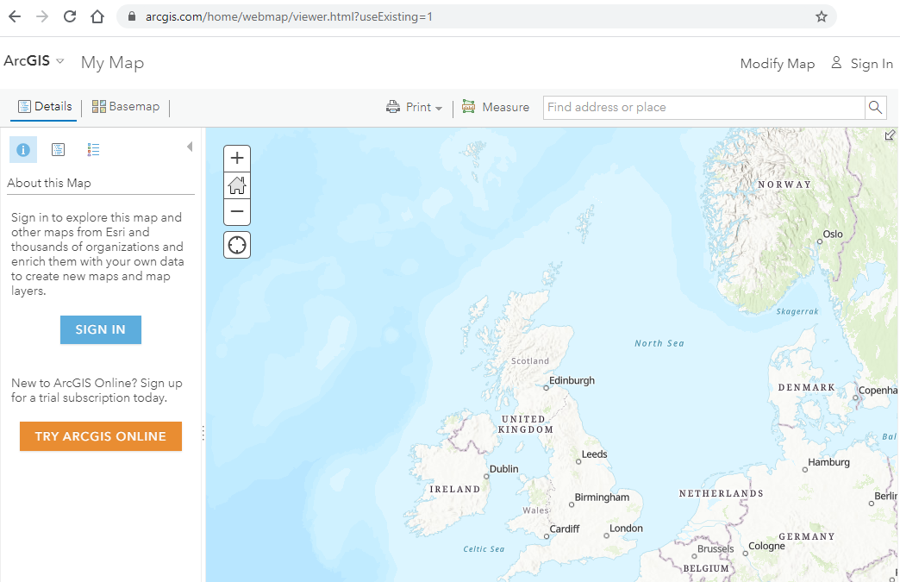
Mapping boat data in the Broads using GIS
Step 2
Visit arcgis.com click on the word
‘map’ on the top toolbar.
Which will take you to this page

Slide 10
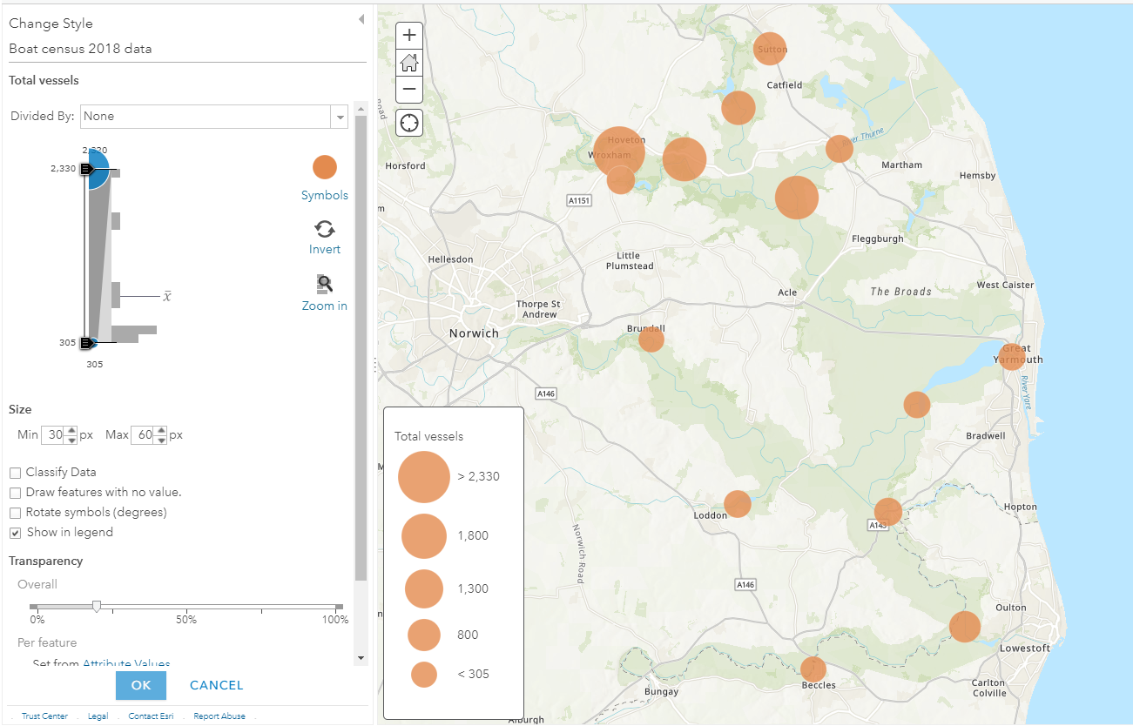
Mapping boat data in the Broads using GIS
Step 3
Now simply drag and drop your Excel file on to the map…
Your data is now displayed geospatially – in the exact location it was gathered

Slide 11
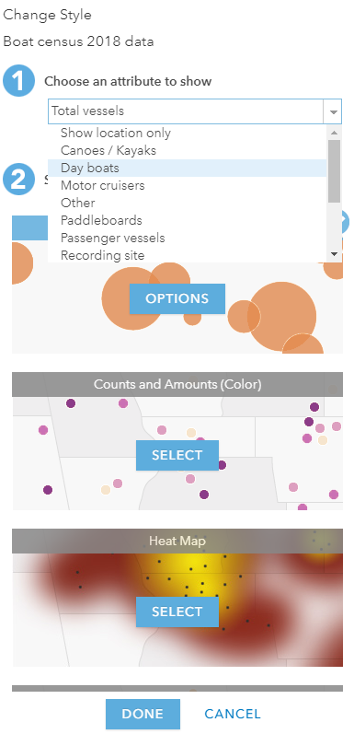
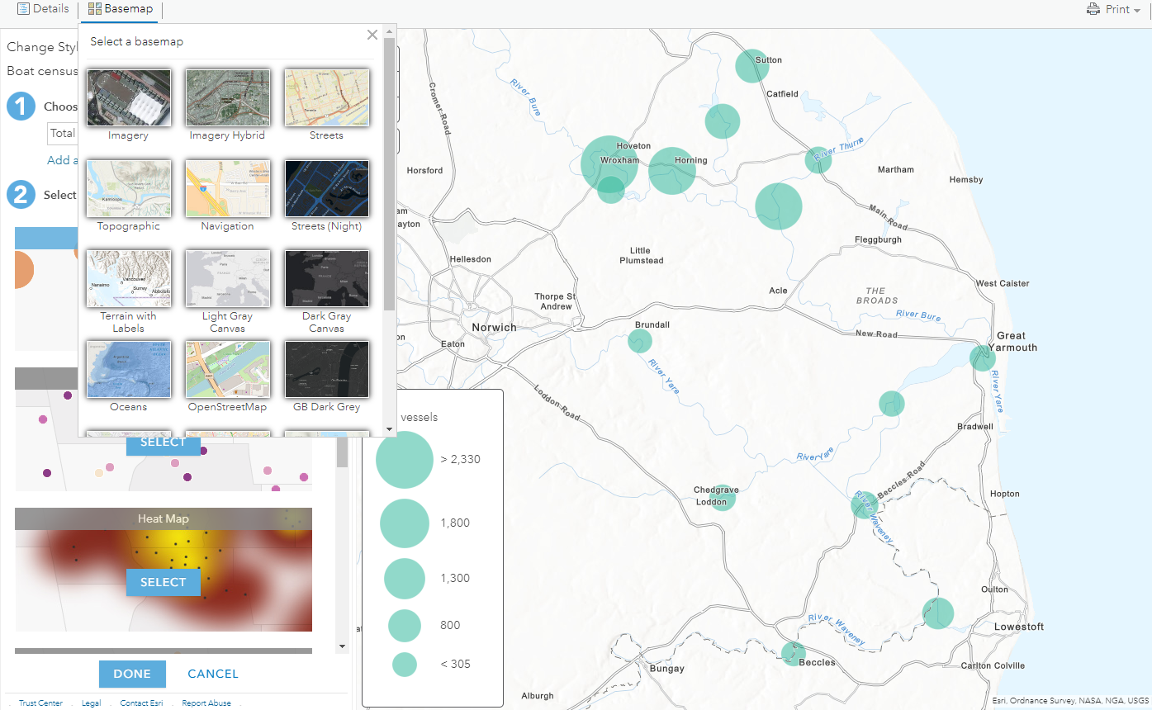
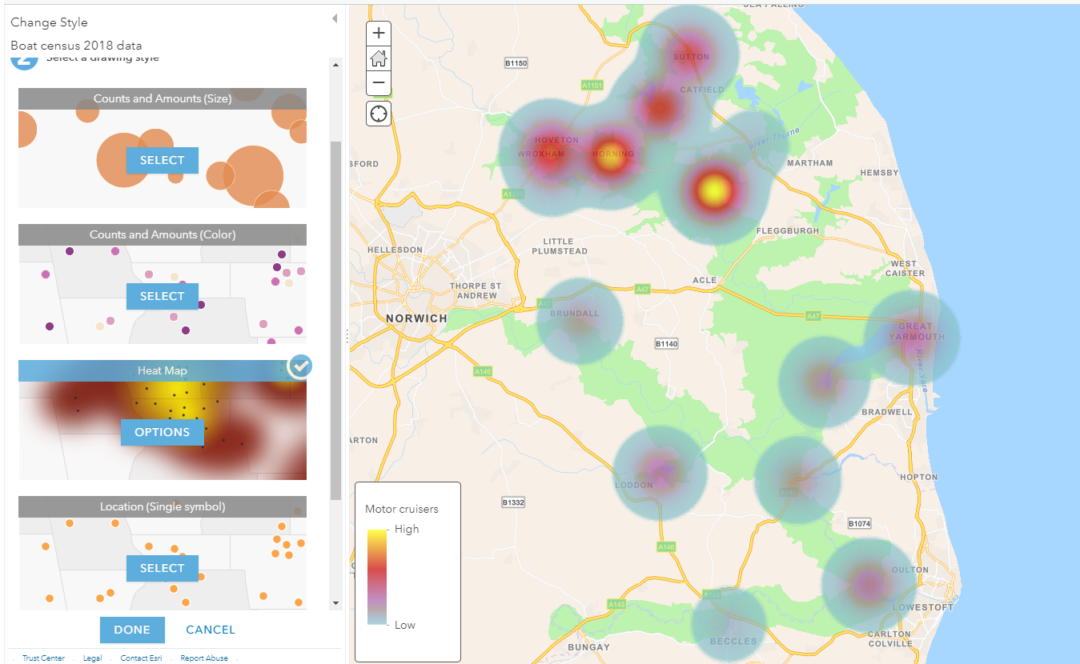
Mapping boat data in the Broads using GIS
Step 4
Explore the functions on the toolbar to display different data sets on a variety of basemaps and in different ways

Slide 12
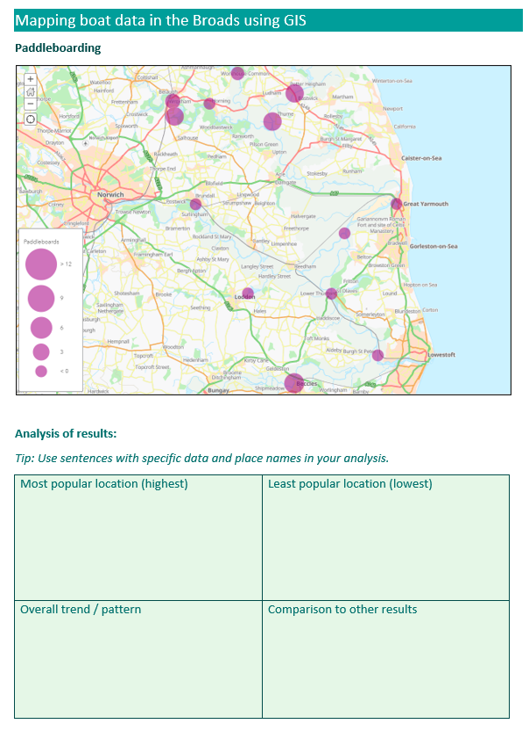
Mapping boat data in the Broads using GIS
Step 5
Printscreen any one of your maps.
Copy and paste into Word
Crop the image
Add a title
Analyse what your map shows
You could use 4 boxes to cover:
Most popular location
least popular location
Overall trend / pattern of your results
How these results compare to the other vessel groups
Print!

Slide 13
In this lesson, we have:
Examined the value of tourism to the Broads
Improved our ability to analyse real data
Mapping boat data in the Broads using GIS
Challenge 1
Challenge 2
Challenge 3
How many tourists does the Broads normally receive each year and how much do they spend?
What does GIS stand for and why is it great!
Specifically, which part of the Broads is busiest with boats?
Educational resource partner providers

