Slide 1
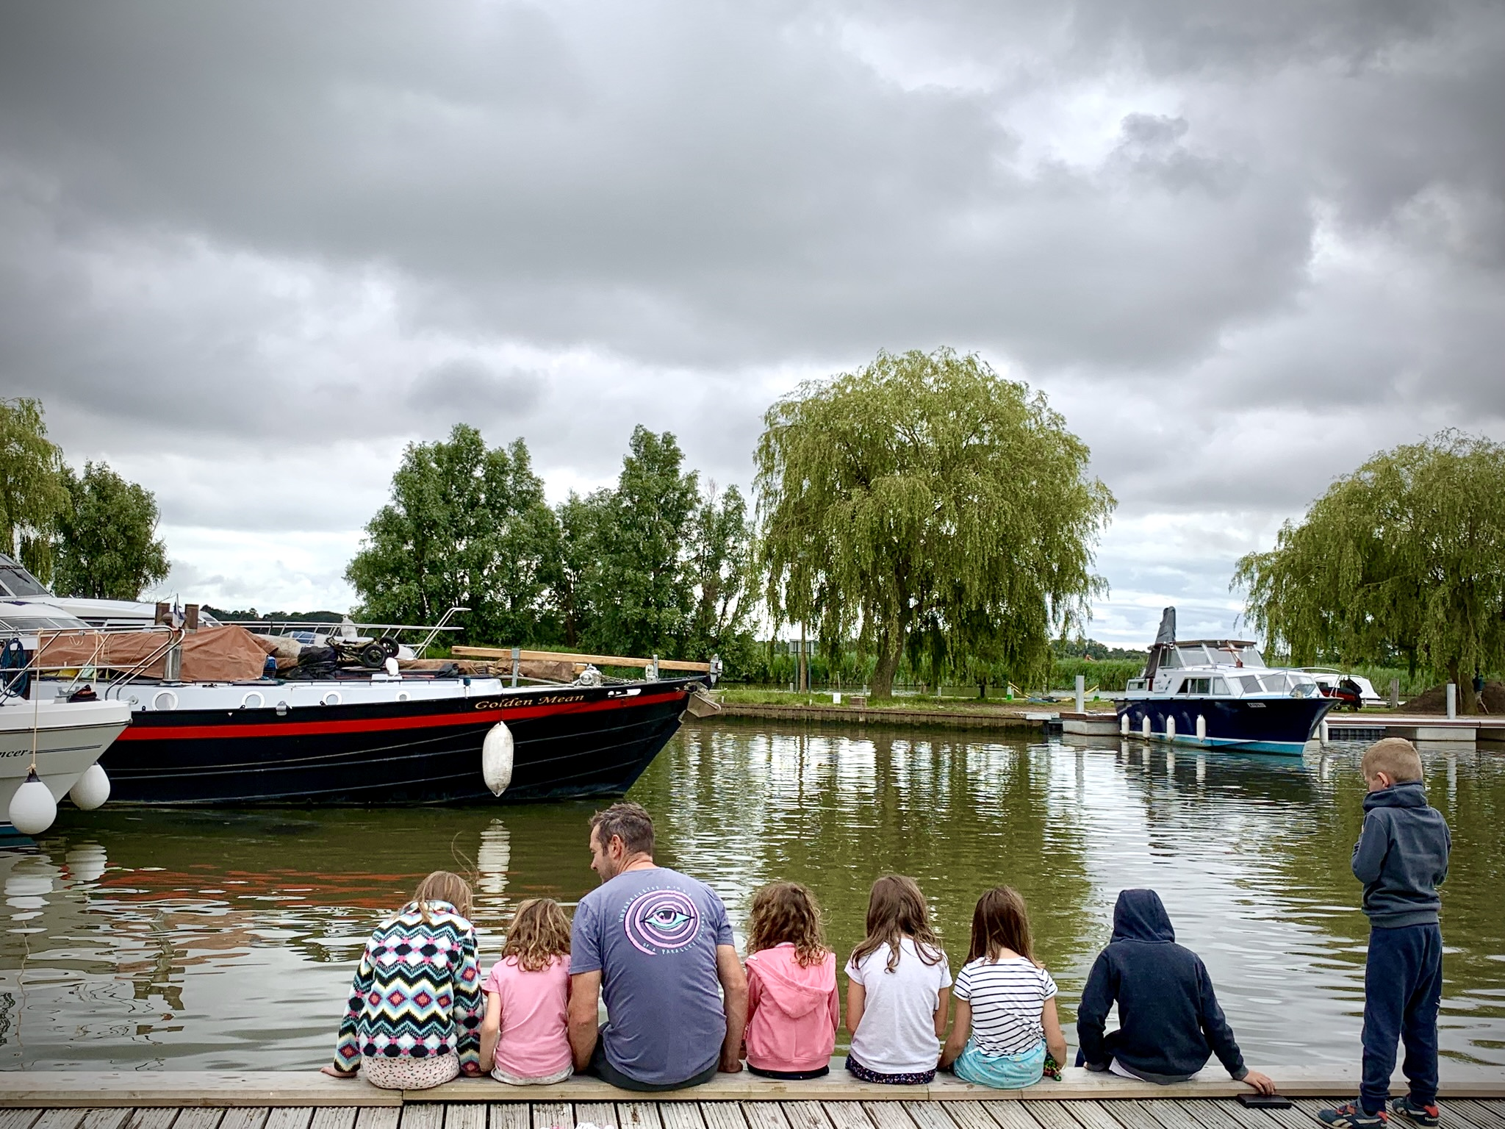
Geog
your memory
How much can you remember from last time?
To the nearest million how many tourists does the Broads receive each year?
What does GIS stand for?
Which site in the Broads is the busiest?
Educational resource partner providers

Slide 2
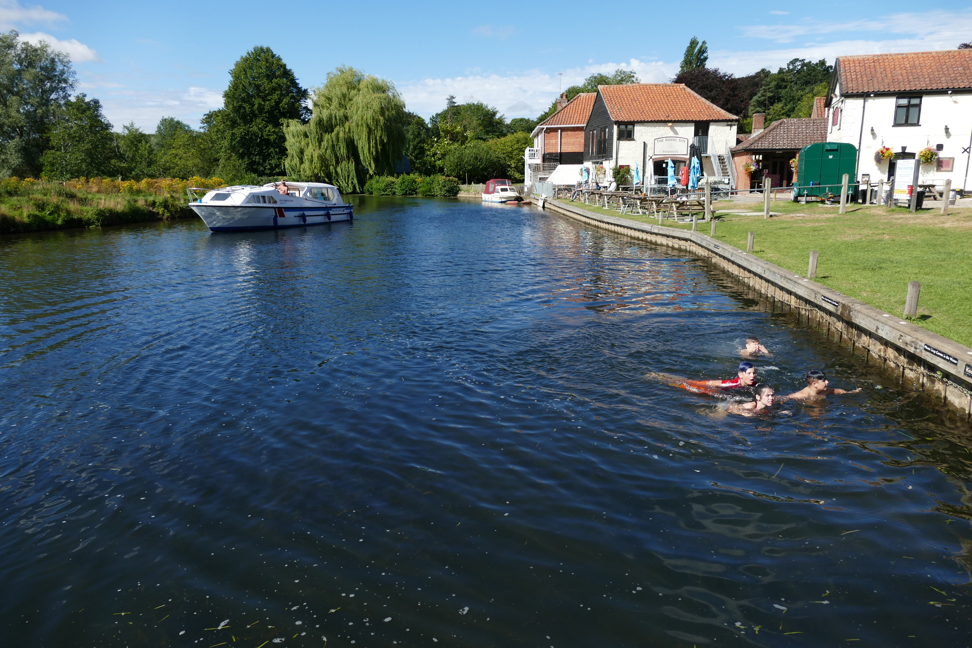
Stakeholders in the Broads
In this lesson, we will:
Understand the term ‘stakeholder’ and consider those relevant to the Broads
Develop skills of note-taking to pick-out key information from 6 stakeholders
Apply our information to consider the relationships between stakeholders

Slide 3
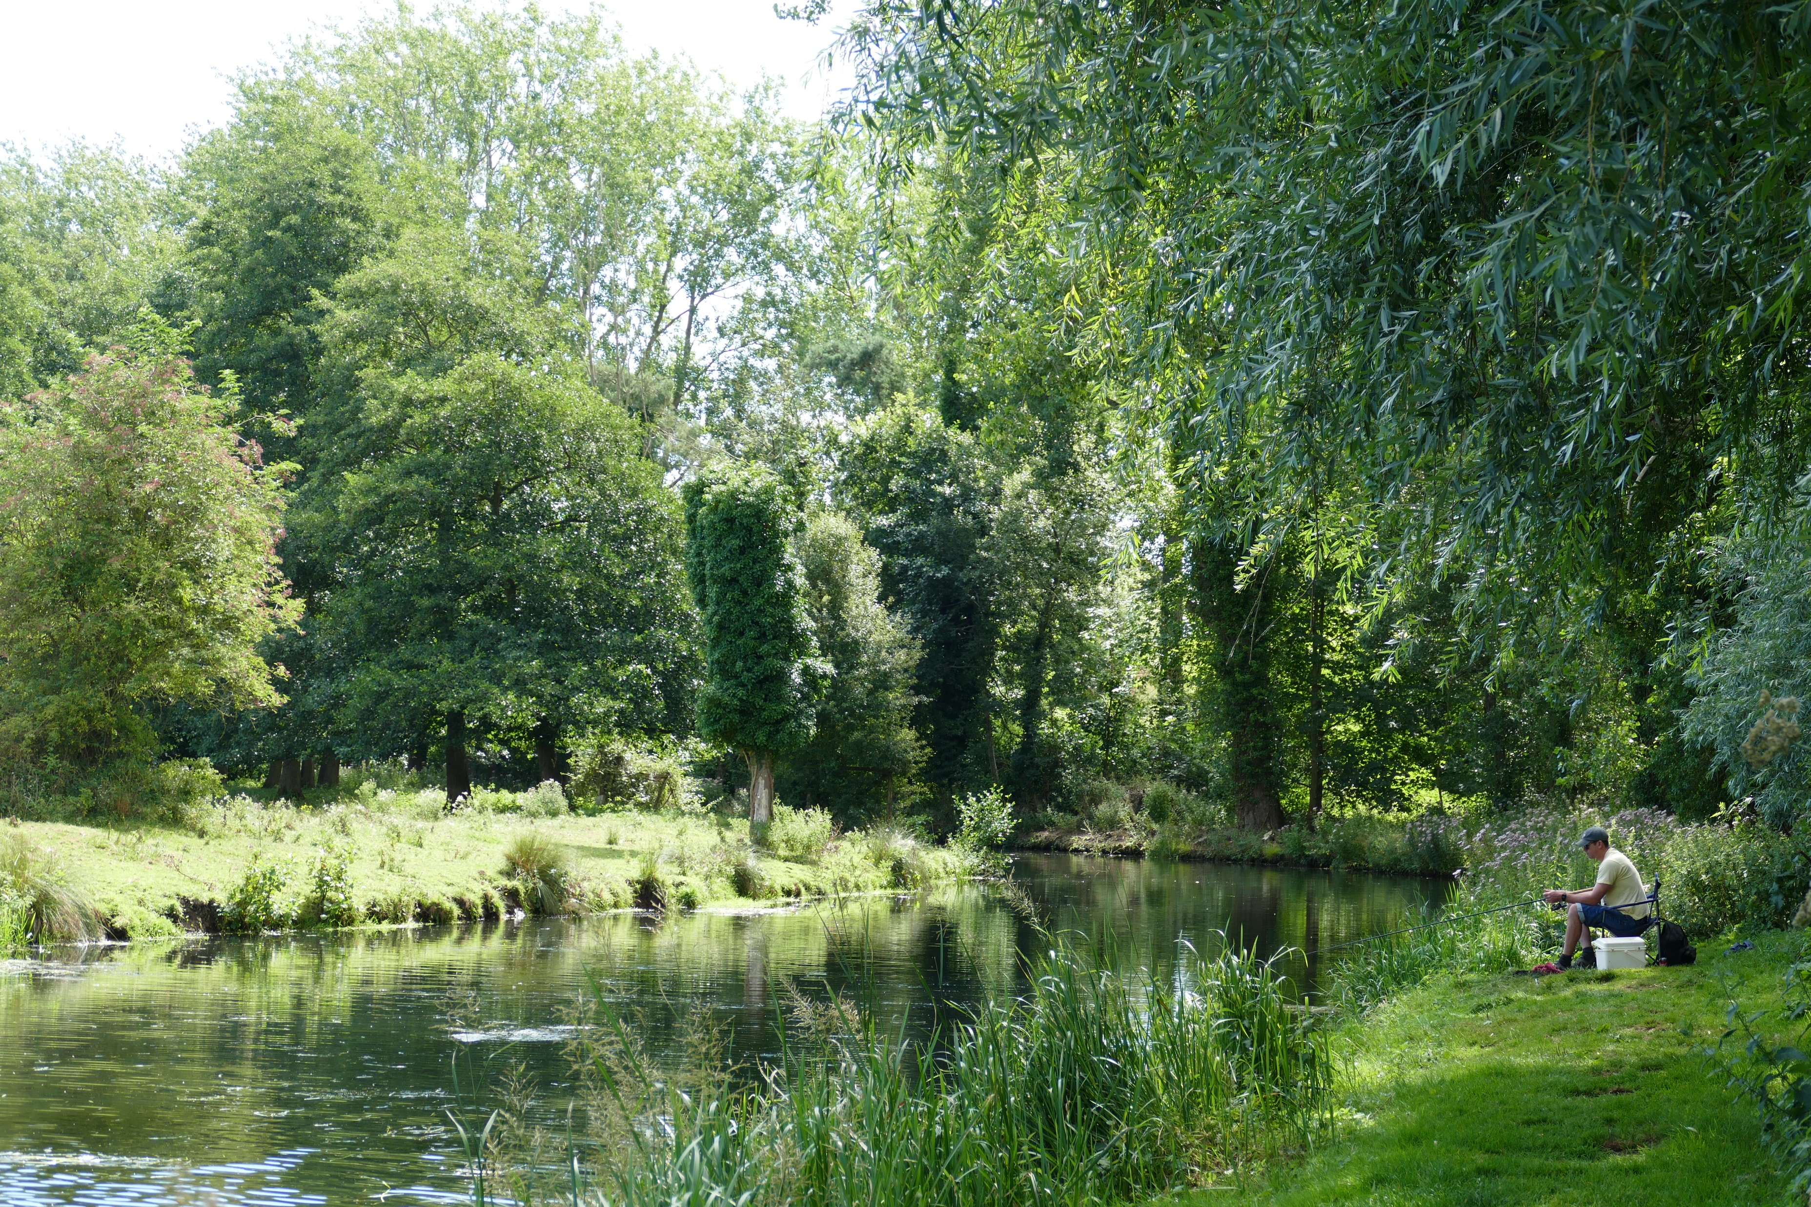
What do we mean by a ‘stakeholder’?
Can you think of 5 different types of STAKEHOLDERS in the Broads?
‘A person or group who have a particular interest or involvement in something or somewhere’

Slide 4
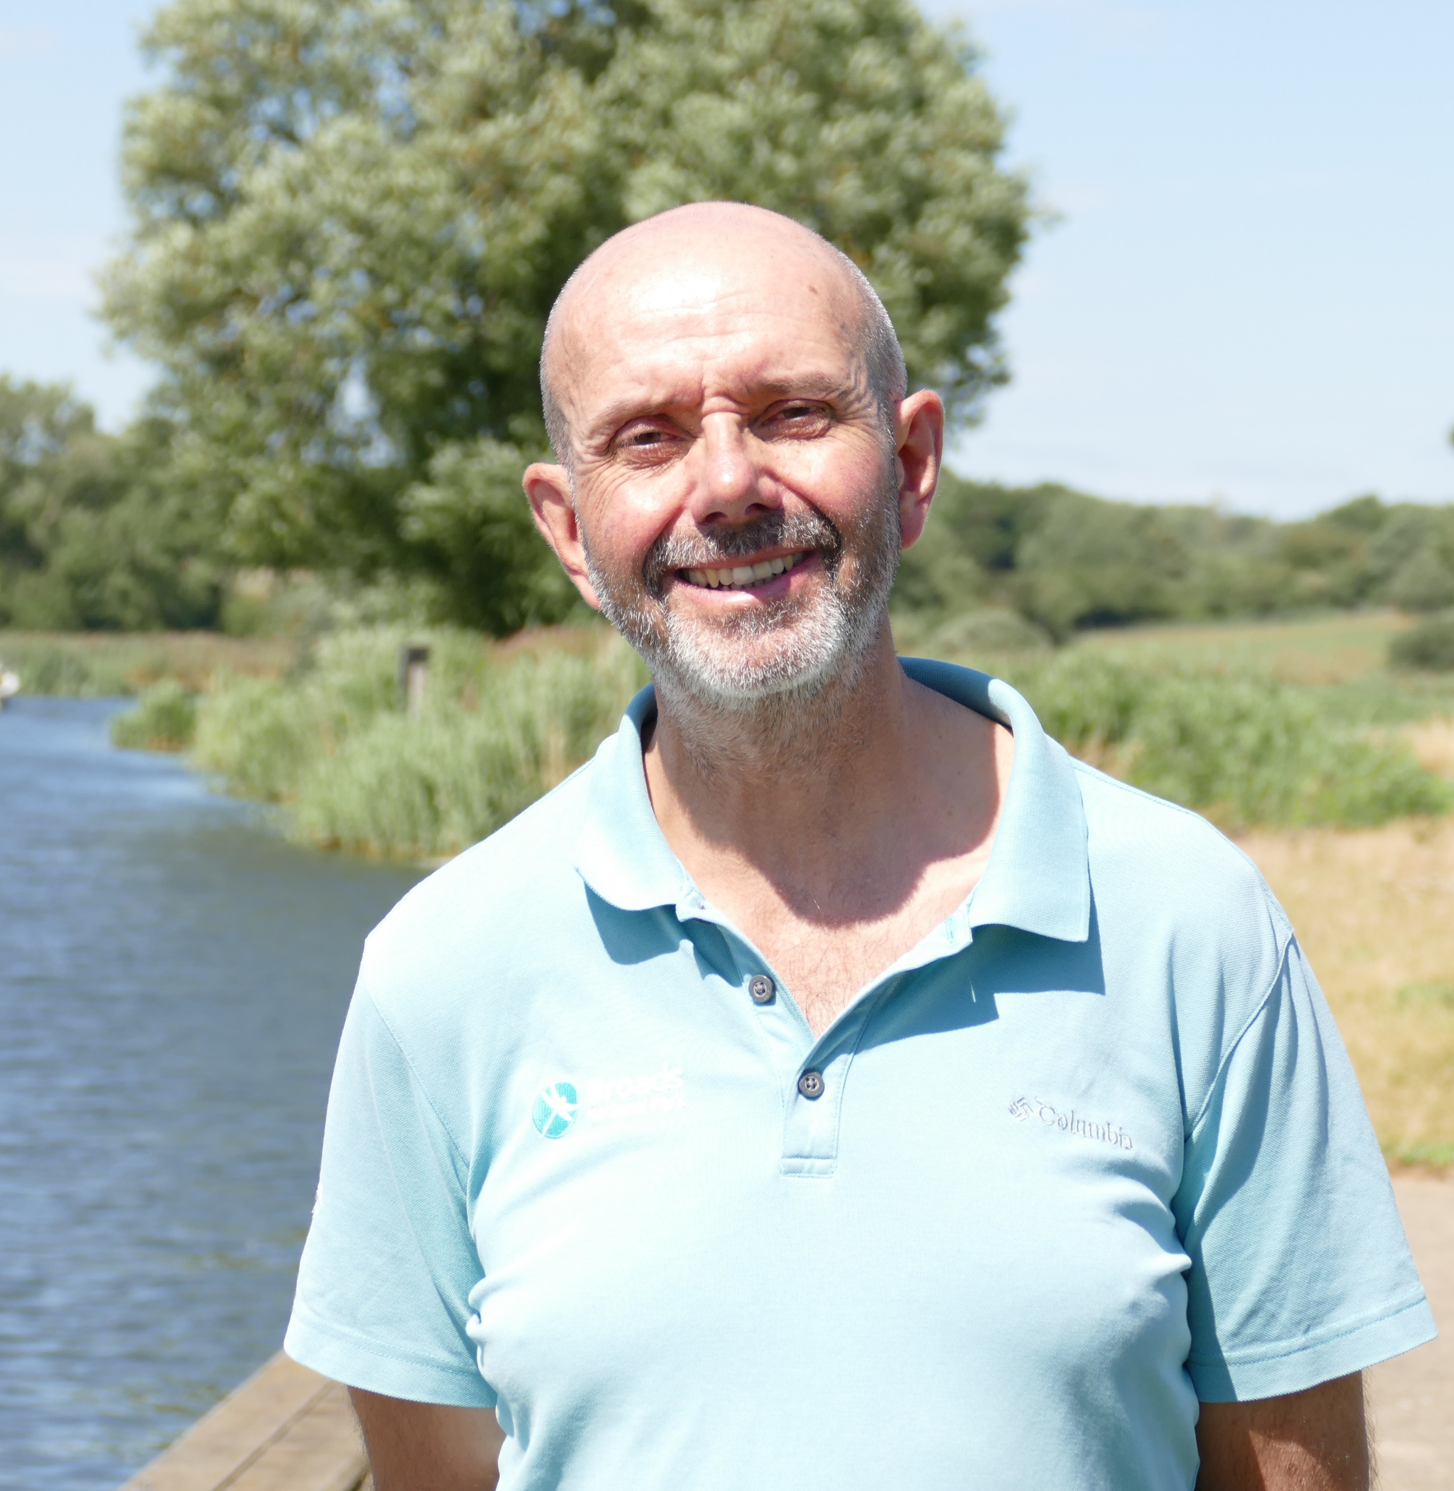
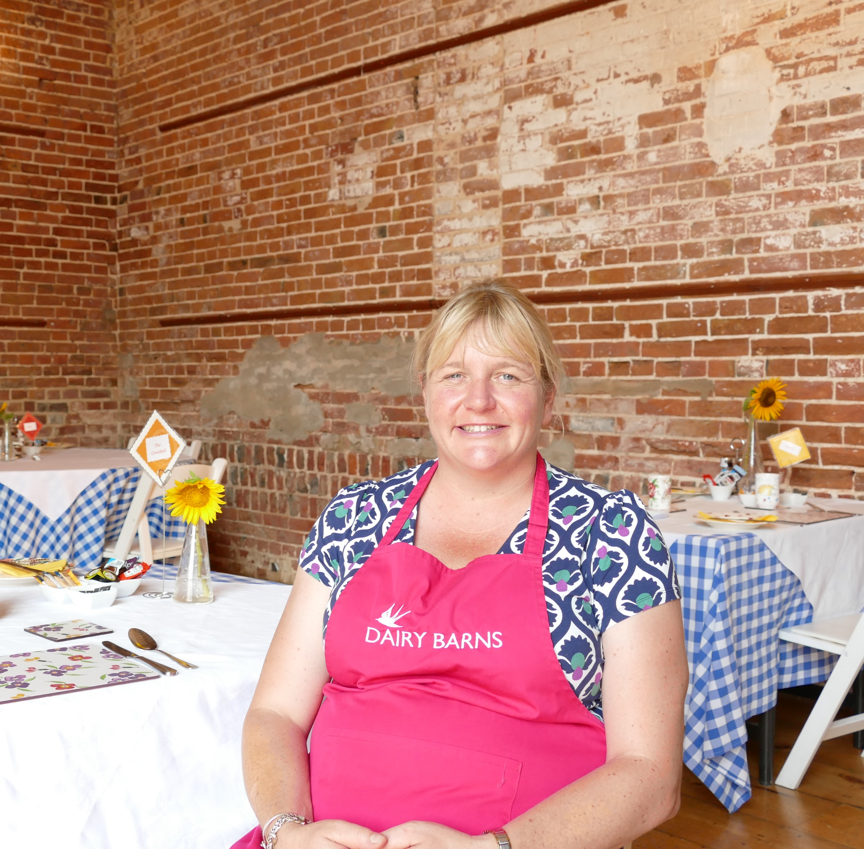
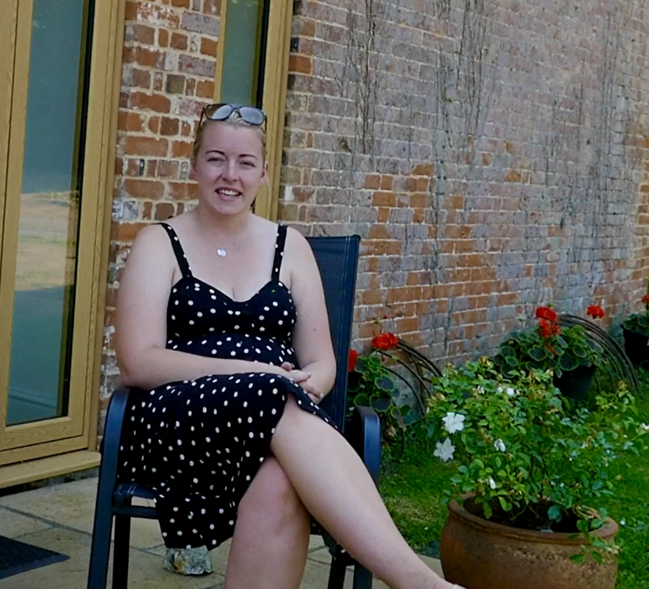
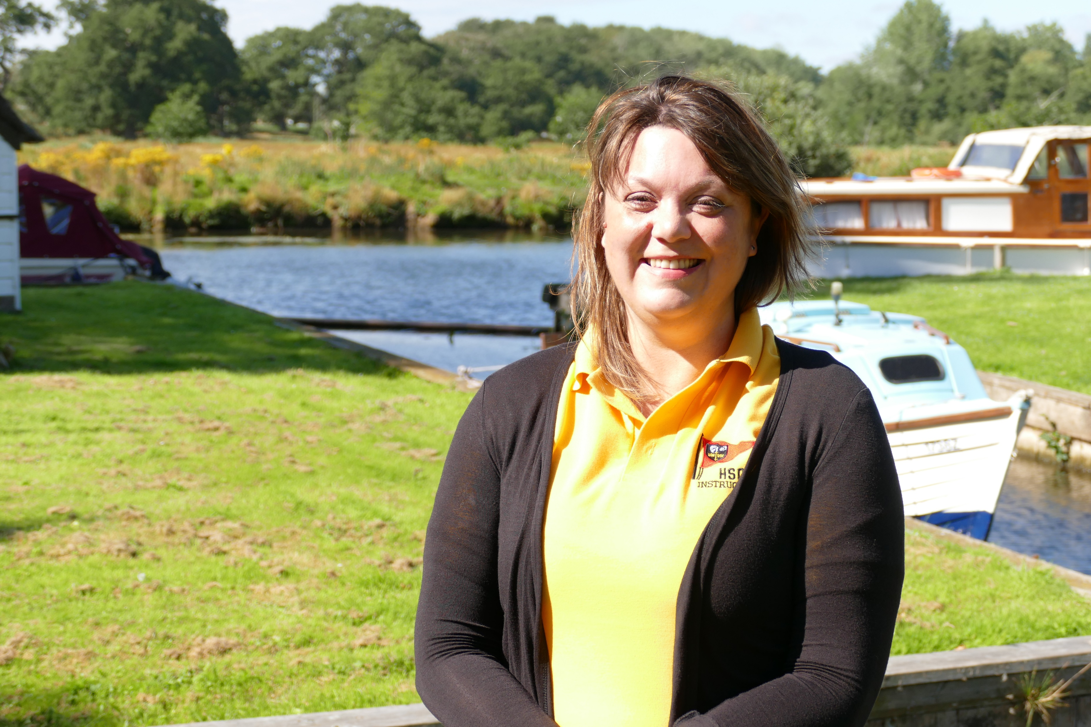
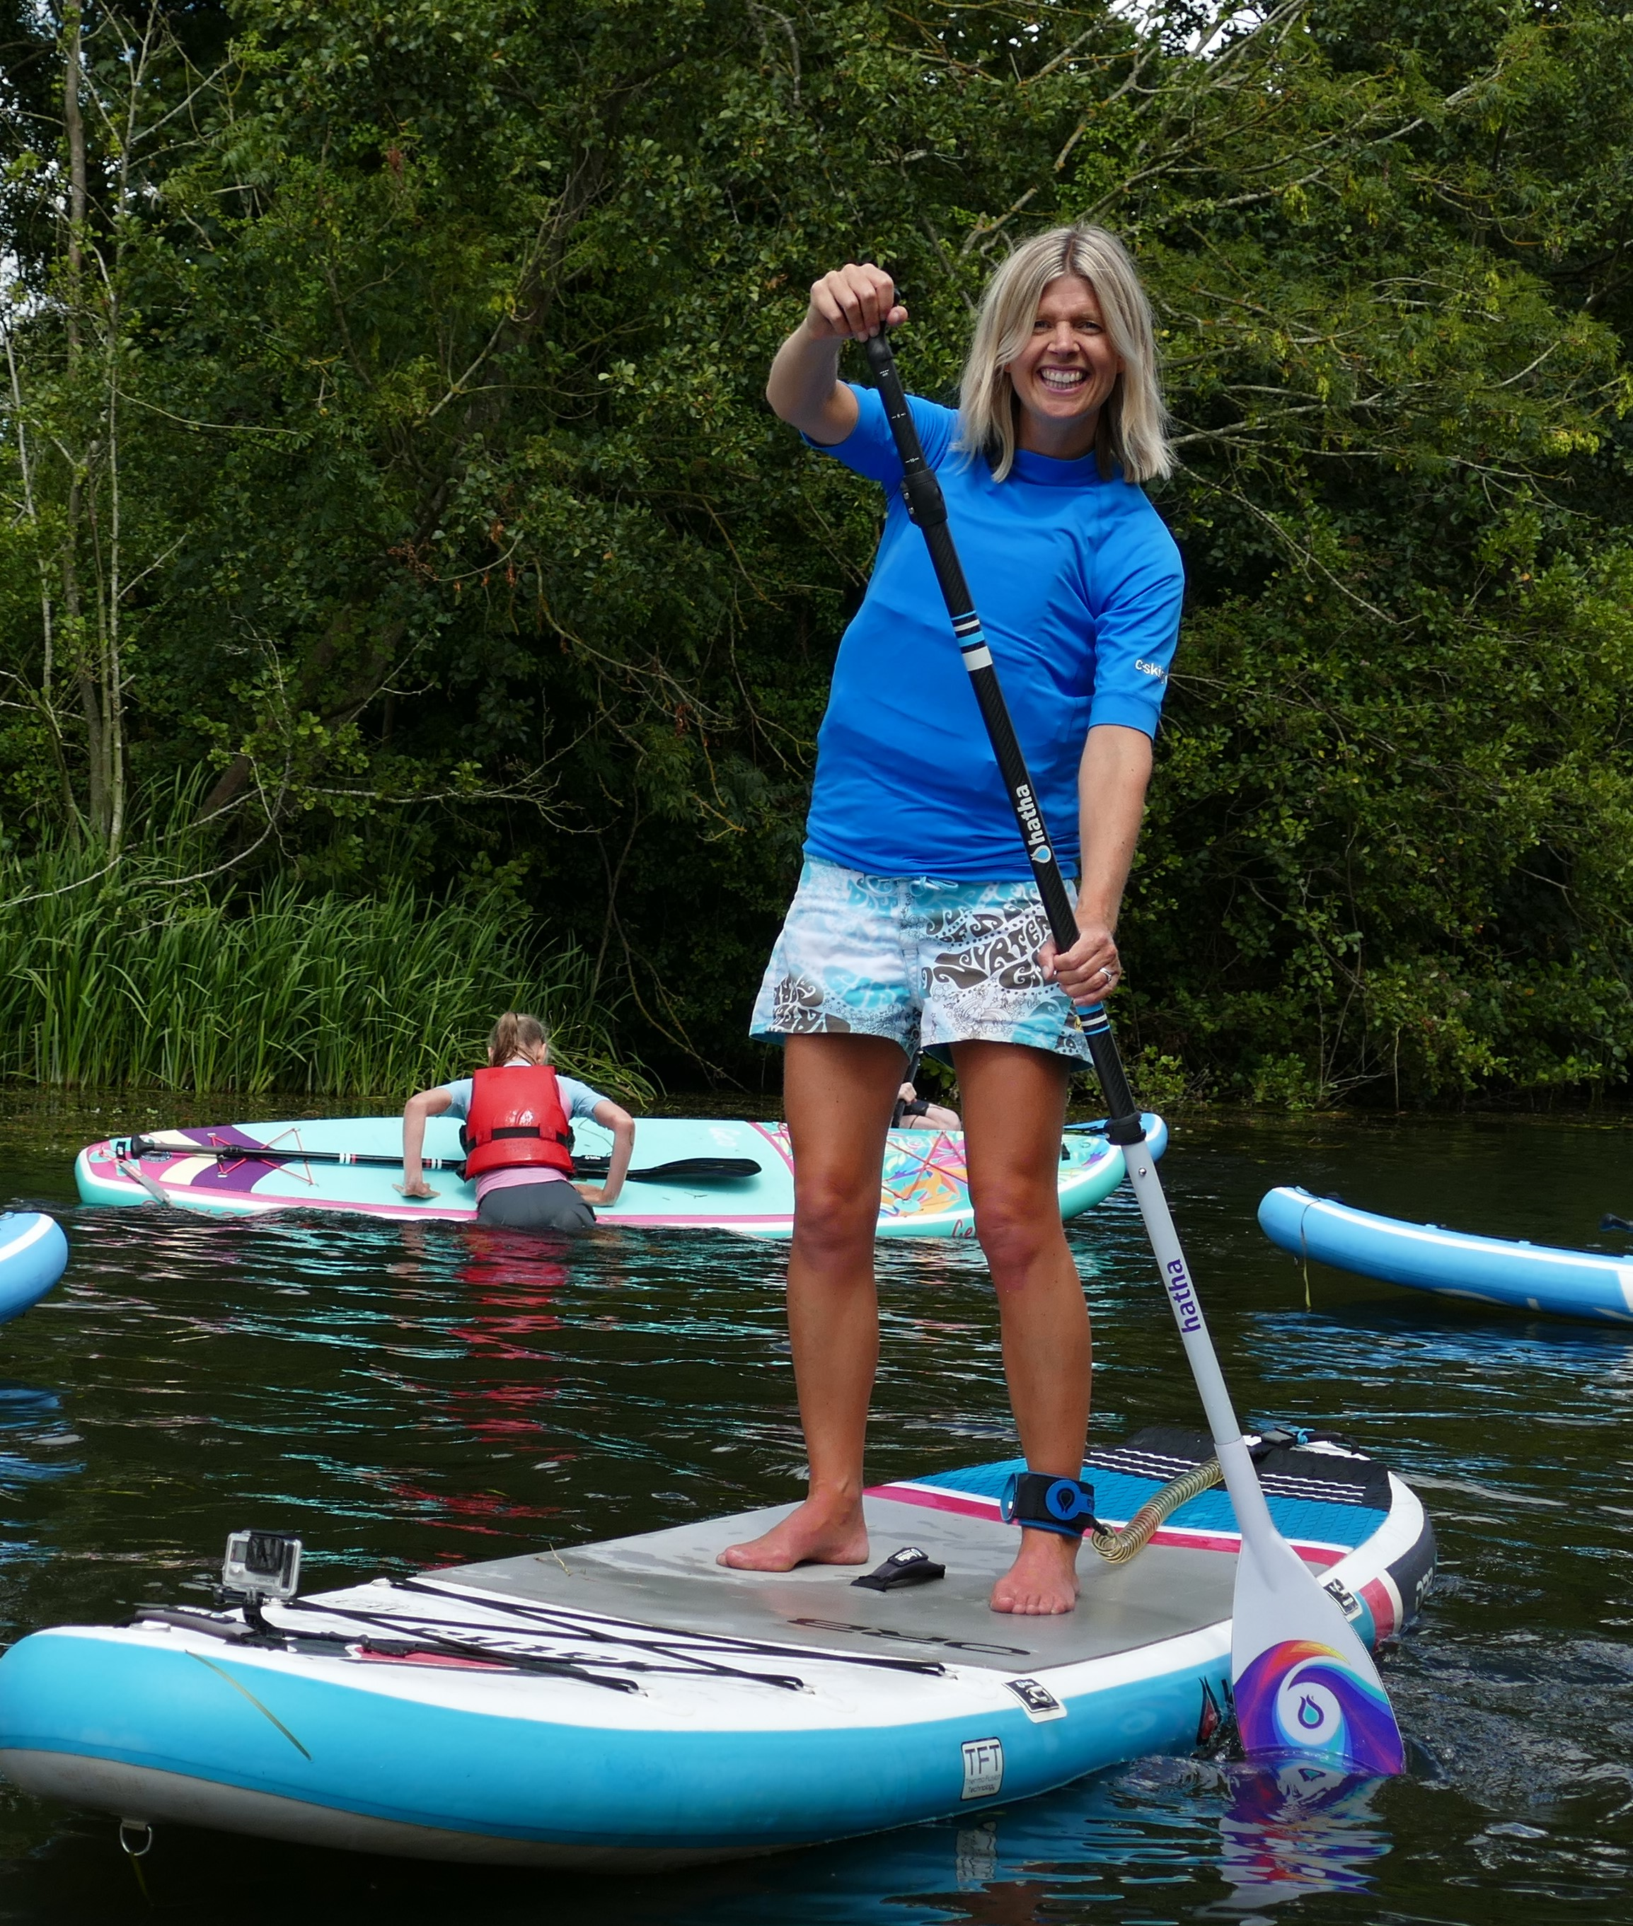
Farmer
Tourist
Broads Authority
Sailing club
Paddleboarding business
Our 6 key stakeholders
In the Broads, it is important that stakeholders collaborate – you’re about to hear from a representative from each of these groups and learn how they are all connected to each other.
Key term:
Collaborate = means working together
Local residents
Notes:
Disclaimer – Although the video mentions the possibility of a future Broads triathlon event, the Broads Authority wish to confirm that at this stage this is hypothetical and all the correct legal procedures and planning would be required before such an event was committed to.

Slide 5
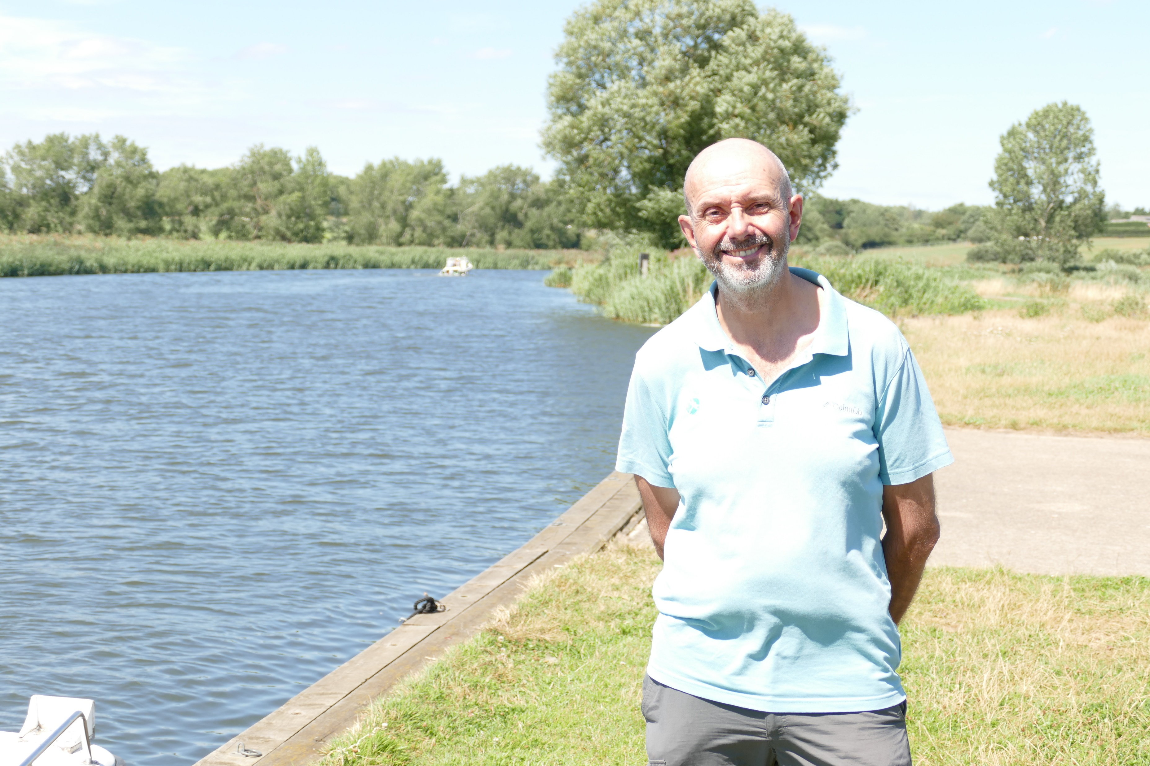
Develop skills of note-taking to pick-out key information
Note-taking tips:
Each person will be asked about their relationships with the other stakeholders. Therefore before you begin, think about how you will organise your notes
Listen out for key information such as:
Figures
Dates
Specific place names
Try to make a brief note for each question asked
Don’t try to write everything down!
Play the Stakeholder video

Slide 6
Farmer
Tourist
Broads Authority
Sailing club
Paddleboarding business
How are all of these stakeholders connected?
Local residents

Slide 7
Apply our information to consider the relationships between stakeholders
Broads Authority
TASK: Use your notes to complete a ‘stakeholder collaboration web’
Draw arrows from each group to others who they collaborate with
Annotate these arrows with details from your notes describing the relationship
Colour-code your web and use key information.
Granted license by BA to operate. Pay tolls for each board goes to maintaining rivers
Paddleboard business
Local resident
Tourists provide significant number of customers. Increasingly popular activity.
Could work with sailing clubs in future to offer low-wind activity
Possibly working with a farmer in the future to offer paddleboarding from a new glamping site.
Sailing club
Tourist
Work with the BA for support with grants when diversifying business
Many of the farm B&B guests are visiting to enjoy sailing on the Broads
Farmer

Slide 8
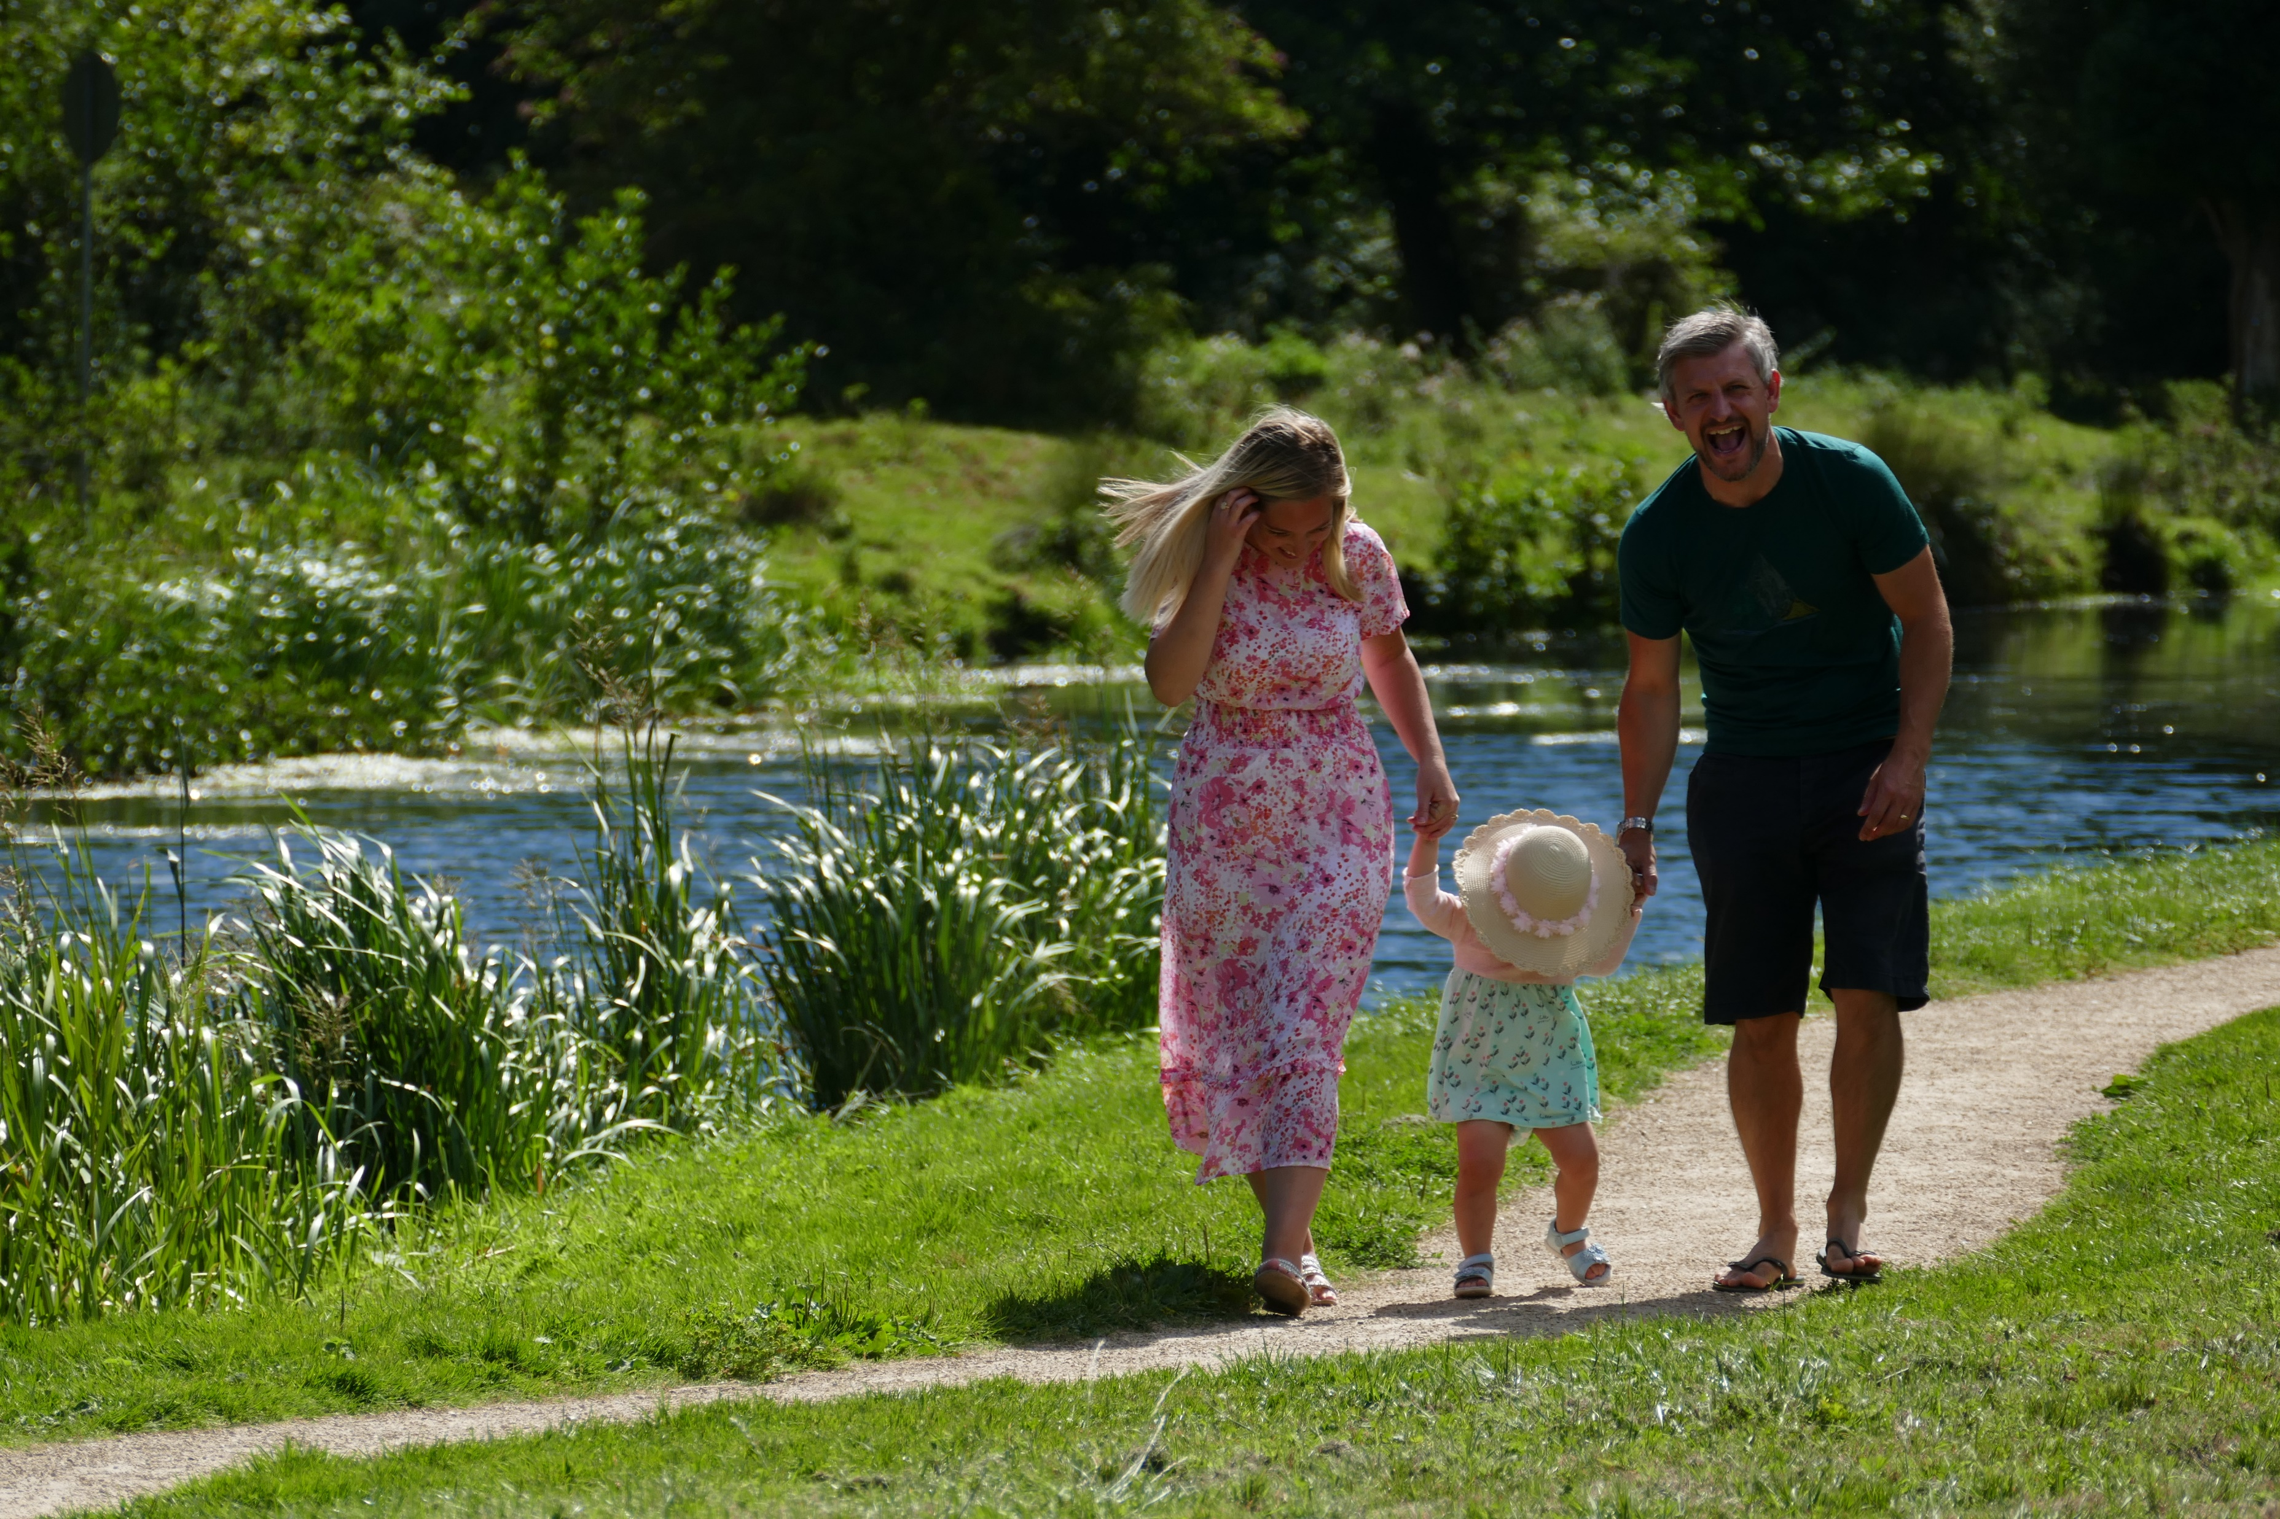
In this lesson, we have:
Used the term ‘stakeholder’ and considered those relevant to the Broads
Developed skills of note-taking to pick-out key information from 6 stakeholders
Applied our information to consider the relationships between stakeholders
Challenge 1
Challenge 2
Challenge 3
Justify the top 3 ‘most important’ stakeholders in the Broads
Quote 1 key fact you have learnt from the interviews
Select the stakeholder who you consider collaborates most with others in the Broads
Educational resource partner providers

